Slide 1
Module-3
Total Quality Management (TQM)-Quality Metrics-Software Quality metric Analysi

Slide 2
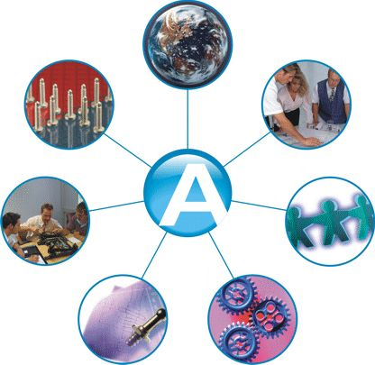
TOTAL QUALITY MANAGEMENT “MUST KNOW” CONCEPTS FOR ENGINEERS

Slide 3
INTRODUCTION TO TQM
What is TQM?
TQM is the integration of all functions and processes within an organization in order to achieve continuous improvement of the quality of goods and services. The goal is customer satisfaction.
“ No doubt , humans are always deficient”
(Al-Quran)

Slide 4
Deming’s 14 points
Deming’s 14 points
Create constancy of purpose towards improvement of product and service, with a plan to become competitive and to stay in business.
Adopt the new philosophy.
Cease dependence on mass inspection.
End of the practice of awarding business on the basis of price tag alone.
Improve constantly and forever the system of production and service.
Institute training.;
Institute leadership.
Drive out fear

Slide 5
Cont. Deming’s 14 points
Bread down barriers between department
Eliminate slogans, exhortations and numerical goals that ask for new levels of productivity without providing methods.
Eliminate numerical quotas.
Remove barriers to pride of workmanship.
Institute a vigorous program of educations and retraining.
Take action to accomplish the transformation.

Slide 6
IV. Total Quality Management Principles
Provide understanding of and guidance on the application of TQM - See Attachment #3
A.Customer-Driven Organization
1. Organizations depend on their customers and therefore should understand current and future customer needs, meet customer requirements, and strive to exceed customer expectations

Slide 7
IV. Total Quality Management Principles (Cont’d)
2. It requires 10 times as much money to attract a new customer than it requires to keep a customer you already have......keep the present customer happy
B. Leadership
1. Leaders establish unity of purpose, direction, and the internal environment of organization; they fully involve people in achieving the organization’s objectives

Slide 8
IV. Total Quality Management Principles (Cont’d)
2. The difference between an average and an outstanding company is the leadership they have
C. Involvement of People
1. People are the essence of an organization and their full involvement enables their knowledge and experiences to be used for the organization’s benefit
2. Employees are a company’s greatest asset

Slide 9
IV. Total Quality Management Principles (Cont’d)
3. An individual without information can not take responsibility; an individual with information can and will take responsibility
D. Process Approach
- A desired result is achieved more effectively when related resources and activities are managed as a process

Slide 10
IV. Total Quality Management Principles (Cont’d)
E. System Approach to Management
- Identifying, understanding, and managing a system of interrelated processes for a given objective will contribute to the effectiveness and efficiency of the organization

Slide 11
IV. Total Quality Management Principles (Cont’d)
F. Continual Improvement
- See Attachment #4
1. Continual improvement is a permanent objective of the organization
2. In the race for quality, there is no finish line
3. Quality comes from within; it comes from the hearts and the minds of the people

Slide 12
IV. Total Quality Management Principles (Cont’d)
G. Factual Approach to Decision Making - Effective decisions and actions are based on the analysis of data and information
H. Mutually Beneficial Supplier Relationships
1. Mutually beneficial relationships are established to enhance the ability of both organizations to create value
2. Relates to Partnering - Lecture 33

Slide 13
Five Approaches of Defining Quality
Harvard professor David Garvin, in his book Managing Quality summarized five principal approaches to define quality.
Transcendent
Product based
User based
Manufacturing based
Value based

Slide 14
Transcendental view
Those who hold the transcendental view would say “I can’t define it, but I know it when I see it”
Advertisers are fond of promoting products in these terms.
“ Where shopping is a pleasure” (supermarket). “We love to fly and it shows" (airline).
Television and print media are awash with such indefinable claims and therein lies the problem:
Quality is difficult to define or to operationalize. It thus becomes elusive when using the approach as basis for competitive advantage. Moreover, the functions of design, production and service may find it difficult to use the definition as a basis for quality management.

Slide 15
PRODUCT BASED
Quality is viewed as a quantifiable or measurable characteristic or attribute. For example durability or reliability can be measured and the engineer can design to that benchmark.
Quality is determined objectively.
Although this approach has many benefits, it has limitation as well. Where quality is based on individual taste or preference, the benchmark for measurement may be misleading.

Slide 16
USER BASED
It is based on idea that quality is an individual matter and products that best satisfy their preferences are those with the highest quality. This is rational approach but leads to two problems;
Consumer preference vary widely and it is difficult to aggregate these preferences into products with wide appeal. This leads to the choice between a niche strategy or a market aggregation approach which tries to identify those product attributes that meet the needs of the largest number of consumers.
Another problem concerns the answer to the question “Are quality and customer satisfaction the same?” the answer is probably not. One may admit that a Lincoln continental has many quality attribute, but satisfaction may be better achieved with an Escort.

Slide 17
MANUFACTURING BASED
Manufacturing-based definitions are concerned primarily with engineering and manufacturing practices and use the universal definition of “conformance to requirements”. Requirements or specifications are established by design and any deviation implies a reduction in quality. The concept applies to services as well as product. Excellence in quality is not necessarily in the eye of the beholder but rather in the standards set by the organization.
This approach has the serious weakness. The consumer’s perception of quality is equated with conformance and hence is internally focused.

Slide 18
Value Based
It is defined in term of costs and prices as well as number of other attributes. Thus, the consumer’s purchased decision is based on quality at an acceptable price. This approach is reflected in the popular Consumer Reports magazine which ranks products and services based on two criteria: Quality and Value.
The highest quality is not usually the best value. That designation is assigned to the “best- buy” product or service.

Slide 19
System
MANAGEMENT OF PROCESS QUALITY
CUSTOMER
FOCUS
AND
SATISFACTION
Driver
HUMAN RESOURCE DEVELOPMENT AND MANAGEMENT
SENIOR
EXECUTIVE
LEADERSHIP
STRATEGIC QUALITY PLANNING
QUALITY
AND
OPERATIONAL
RESULTS
INFORMATION AND ANALYSIS
System Approach for TQM

Slide 20
Stages of TQM
Quality Control
Monitoring variations
Quality Assurance
Standards based
Quality Improvement
Process oriented
Quality Management
Internally motivated
Total Quality Management
Changed organizational culture

Slide 21
Benefits of TQM
A. Better defined project scope and objectives
B. Greater communication of objectives
C. Teamwork
D. Effective planning and scheduling
E. Appropriate Training

Slide 22
Benefits of TQM (Cont’d)
F. Improved quality of materials, equipment, and workmanship
Case Studies - See Attachment #13

Slide 23
Benefits of TQM
Greater customer loyalty
Market share improvement
Higher stock prices
Reduced service calls
Higher prices
Greater productivity

Slide 24
TQM to Software Development Process
One of Deming ideas was the Plan, Do, Check, Action, which is often shortened to PDCA.
We can use PDCA cycle as the basic idea, for software processes development to gain software quality

Slide 25

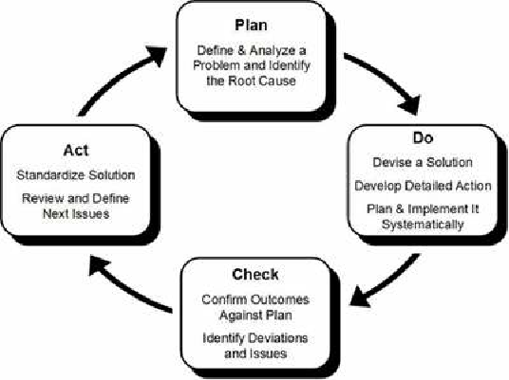
PDCA CYCLE

Slide 26
DST- PDCA Cycle
- In the Beginning, There is a Dream
(Honda Management Policy-1: Proceed always with ambition and youthfulness)
A Honda work style is to proceed with work by picturing your ideal state such as ‘want to do this, want to be like this.’
Difficulty
Three stages of an ideal state
- The DST-PDCA Cycle
Innovating
level
Draw, See and Think –PDCA Cycle
Theme finding/setting
Problem solving level
Draw
See
Think
Picture ones’
Ideal State
Recognise Reality
Consider what
needs to be done
Improving
level.
Want to do this
Want to be like this
Grasp and analyze current situation
Draw out themes of
what should do
Time
Plan
Do
Check
Act
D
S
Check by actual
results
Take responsive
countermeasures
Make action plan
Put plans into action
A
Ｐ
T
Plans &
standards
Training &
implementation
Analysis &
learning
Improvement &
standardization
C
D
Action Plan Implementation
By adding the DST cycle, we can keep the PDCA cycle rotating on one’s own initiative.

Slide 27
DST Cycle
- What is the DST Cycle for?
To add your own ideas to your action planning
- DST cycle
See
Recognise the Reality
Draw
Picture Ones’ Ideal State
Recognise the reality by the Three Reality Principle, Gap Analysis of Plan vs. Actual, Future Prediction and Comparison with Competitors.
Express your ideas of ‘want to do this, want to be like this.’
S
D
Ｐ
T
Plan
Action Planning
Think
Action plan with 5W2H to implement activities of what the theme requires.
5W2H: Why, what, when, who,
where, how to and how much (or how many)
Consider what needs to be done
Based on the gap analysis of your ideal and actual state, draw out themes of ‘what needs to be done.’
Do
Check
Act

Slide 28
PDCA Cycle – the purpose and process
- What is the PDCA Cycle for?
Achieving objectives effectively and efficiently by rotating the PDCA cycle of Action Plan.
Standar- dization
Plan
Make
Action Plan
Take responsive counter-measures
Improve
Standard
ACT
Clarify Operation Standard
PLAN
(IMPROVE)
（STANDARD）
Study/
Learn
CHECK
DO
Train
(STUDY)
Analyze
Implement
Check by
actual result
Put plans into action

Slide 29
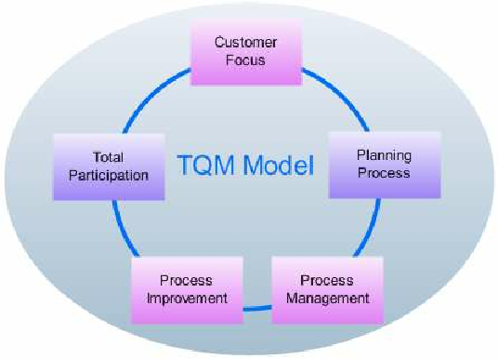
TOTAL QUALITY MANAGEMENT
TOTAL QUALITY MANAGEMENT

Slide 30



PDCA & TQM DOSTI!!
✓ The basic need of TQM is
continuous improvement.
PDCA
TQM
✓ In this competition world if
you are not in the race you
will loss.
✓ For
continuous
improvement purpose PCDA
cycle acts as a best tool, so as
to achieve Quality
this
✓ Also called as deming cycle

Slide 31
PROCESS TO OBTAIN TQM BY
PDCA
✓ Select the project in which TQM to be achieved
✓ Grasp the present status
✓ Analyze the cause
✓ Determine the corrective action
✓ Implement corrective action
✓ Check the effects in terms of quality
✓ Take appropriate action
✓ Conclude and future plans to obtain TQM

Slide 32


PLAN

Slide 33
✓ Select the project in which TQM TO BE IMPLEMENTED
-Project background and reasons for selection
-Set a target
-Prepare a schedule of activities
✓ Grasp the Current status
✓ Analyze the cause and Determine the Corrective Action
-Prepare cause and effect diagram
-Prepare a hypothesis and verify most likely causes
-Document the corrective action

Slide 34


DO

Slide 35
• Implement the corrective action
Prepare instructions and flow charts for
complicated procedures
Adequate training must be provided
Follow the plan exactly
Record any division from plan and collect the
data on results

Slide 36

CHECK

Slide 37
• Check the Effect of corrective action
– Compare over all results
– Analyse failure to achieve results
– Results achieved

Slide 38


Slide 39
• Check appropriate action
– Documentation, standardisation and control
– Training
– Decide on future plans
– The well known seven quality control tools may be
used in this process

Slide 40
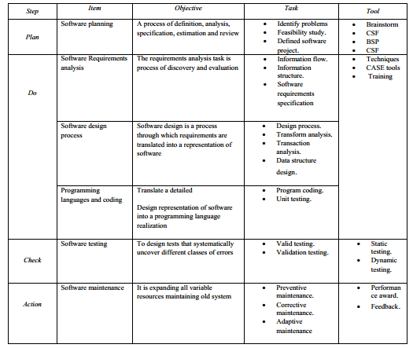

Slide 41
Measurement, Measures, Metrics
Measurement
is the act of obtaining a measure
Measure
provides a quantitative indication of the size of some product or process attribute, E.g., Number of errors
Metric
is a quantitative measure of the degree to which a system, component, or process possesses a given attribute (IEEE Software Engineering Standards 1993) : Software Quality - E.g., Number of errors found per person hours expended

Slide 42
What to measure
Process
Measure the efficacy of processes. What works, what doesn't.
Project
Assess the status of projects. Track risk. Identify problem areas. Adjust work flow.
Product
Measure predefined product attributes

Slide 43
What to measure
Process
Measure the efficacy of processes. What works, what doesn't.
Code quality
Programmer productivity
Software engineer productivity
Requirements,
design,
testing
and all other tasks done by software engineers
Software
Maintainability
Usability
And all other quality factors
Management
Cost estimation
Schedule estimation, Duration, time
Staffing

Slide 44
Process Metrics
Process metrics are measures of the software development process, such as
Overall development time
Type of methodology used
Process metrics are collected across all projects and over long periods of time.
Their intent is to provide indicators that lead to long-term software process improvement.

Slide 45
Project Metrics
Project Metrics are the measures of Software Project and are used to monitor and control the project. Project metrics usually show how project manager is able to estimate schedule and cost
They enable a software project manager to:
Minimize the development time by making the adjustments necessary to avoid delays and potential problems and risks.
Assess product cost on an ongoing basis & modify the technical approach to improve cost estimation.

Slide 46
Product metrics
Product metrics are measures of the software product at any stage of its development, from requirements to installed system. Product metrics may measure:
How easy is the software to use
How easy is the user to maintain
The quality of software documentation
And more ..

Slide 47
Why do we measure?
Determine quality of piece of software or documentation
Determine the quality work of people such software engineers, programmers, database admin, and most importantly MANAGERS
Improve quality of a product/project/ process

Slide 48
Why Do We Measure?
To assess the benefits derived from new software engineering methods and tools
To close the gap of any problems (E.g training)
To help justify requests for new tools or additional training

Slide 49
Examples of Metrics Usage
Measure estimation skills of project managers (Schedule/ Budget)
Measure software engineers requirements/analysis/design skills
Measure Programmers work quality
Measure testing quality
And much more …

Slide 50
IEEE definitions of
software quality metrics
(1) A quantitative measure of the degree to which an item possesses a given quality attribute.
(2) A function whose inputs are software data and whose output is a single numerical value that can be interpreted as the degree to which the software possesses a given quality attribute.

Slide 51
Main objectives of
software quality metrics
1. Facilitate management control, planning and managerial intervention. Based on:
· Deviations of actual from planned performance.
· Deviations of actual timetable and budget performance from planned.
2. Identify situations for development or maintenance process improvement (preventive or corrective actions). Based on:
· Accumulation of metrics information regarding the performance of teams, units, etc.

Slide 52
Software size (volume) measures
KLOC — classic metric that measures the size of software by thousands of code lines.
Number of function points (NFP) — a measure of the development resources (human resources) required to develop a program, based on the functionality specified for the software system.

Slide 53
Process metrics categories
Process metrics categories
Software process quality metrics
Error density metrics
Error severity metrics
Software process timetable metrics
Software process error removal effectiveness metrics
Software process productivity metrics

Slide 54
Is KLOC enough ?
What about number of errors (error density)?
What about types of errors (error severity) ?
A mixture of KLOC, density, and severity is an ideal quality metric to programmers quality of work and performance

Slide 55
An example
2 different project programmers are working on two similar modules
Programmer A– produced 342 errors during software process before release
Programmer B- Produced 184 errors
Which Programmer do you think is better ?

Slide 56
An example
It really depends on the types of errors found (severity) and not only the number of errors (Density)
One error of high severity might be more important than hundreds of other types of errors

Slide 57
Error density metrics
Code | Name | Calculation formula
CED | Code Error Density | NCE CED = ----------- KLOC
DED | Development Error Density | NDE DED = ----------- KLOC
WCED | Weighted Code Error Density | WCE WCDE = --------- KLOC
WDED | Weighted Development Error Density | WDE WDED = --------- KLOC
WCEF | Weighted Code Errors per Function Point | WCE WCEF = ---------- NFP
WDEF | Weighted Development Errors per Function Point | WDE WDEF = ---------- NFP
NCE = The number of code errors detected by code inspections and testing.
NDE = total number of development (design and code) errors) detected in the development process.
WCE = weighted total code errors detected by code inspections and testing.
WDE = total weighted development (design and code) errors detected in development process.

Slide 58
Error severity metrics
Code | Name | Calculation formula
ASCE | Average Severity of Code Errors | WCE ASCE = ----------- NCE
ASDE | Average Severity of Development Errors | WDE ASDE = ----------- NDE
NCE = The number of code errors detected by code inspections and testing.
NDE = total number of development (design and code) errors detected in the development process.
WCE = weighted total code errors detected by code inspections and testing.
WDE = total weighted development (design and code) errors detected in development process.

Slide 59
Software process
timetable metrics
Code | Name | Calculation formula
TTO | Time Table Observance | MSOT TTO = ----------- MS
ADMC | Average Delay of Milestone Completion | TCDAM ADMC = ----------- MS
MSOT = Milestones completed on time.
MS = Total number of milestones.
TCDAM = Total Completion Delays (days, weeks, etc.) for all milestones.

Slide 60
Time Table Metric Example
TTO
Milestones are Requirements, Analysis, Design, Implementation, and Testing
Milestones completed in time are Requirements and analysis only
TTO = 2/5

Slide 61
Time Table Metric Example
ADMC
Requirements (One week delay, Analysis (Three weeks delay, Design (Two weeks delay, Implementation (Six weeks delay), and Testing (Two weeks delay)
Total Delay is 14 Weeks
ADMS = 14/5

Slide 62
Error removal
effectiveness metrics
Code | Name | Calculation formula
DERE | Development Errors Removal Effectiveness | NDE DERE = ---------------- NDE + NYF
DWERE | Development Weighted Errors Removal Effectiveness | WDE DWERE = ------------------ WDE+WYF
NDE = total number of development (design and code) errors) detected in the development process.
WCE = weighted total code errors detected by code inspections and testing.
WDE = total weighted development (design and code) errors detected in development process.
NYF = number software failures detected during a year of maintenance service.
WYF = weighted number of software failures detected during a year of maintenance service.

Slide 63
Error removal effectiveness metrics
DERE
Number of errors detected at design and coding stages is 100
Number of errors detected after one year of maintenance service is 500
DERE= 100/(100+500)

Slide 64
Process productivity
metrics
Code | Name | Calculation formula
DevP | Development Productivity | DevH DevP = ---------- KLOC
FDevP | Function point Development Productivity | DevH FDevP = ---------- NFP
CRe | Code Reuse | ReKLOC Cre = -------------- KLOC
DocRe | Documentation Reuse | ReDoc DocRe = ----------- NDoc
DevH = Total working hours invested in the development of the software system.
ReKLOC = Number of thousands of reused lines of code.
ReDoc = Number of reused pages of documentation.
NDoc = Number of pages of documentation.

Slide 65
Product metrics
categories
* Help Desk (HD) quality metrics:
* HD calls density metrics - measured by the number of calls.
* HD calls severity metrics - the severity of the HD issues raised.
* HD success metrics – the level of success in responding to HD calls.
* HD productivity metrics.
* HD effectiveness metrics.
* Corrective maintenance quality metrics.
* Software system failures density metrics
* Software system failures severity metrics
* Failures of maintenance services metrics
* Software system availability metrics
* Corrective maintenance productivity and effectiveness metrics.

Slide 66
HD calls density metrics
Code | Name | Calculation Formula
HDD | HD calls density | NHYC HDD = -------------- KLMC
WHDD | Weighted HD calls density | WHYC WHYC = ------------ KLMC
WHDF | Weighted HD calls per function point | WHYC WHDF = ------------ NMFP
NHYC = the number of HD calls during a year of service.
KLMC = Thousands of lines of maintained software code.
WHYC = weighted HD calls received during one year of service.
NMFP = number of function points to be maintained.

Slide 67
Severity of HD calls metrics
Code | Name | Calculation Formula
ASHC | Average severity of HD calls | WHYC ASHC = -------------- NHYC
NHYC = the number of HD calls during a year of service.
WHYC = weighted HD calls received during one year of service.

Slide 68
HD success metrics
Code | Name | Calculation Formula
HDS | HD service success | NHYOT HDS = -------------- NHYC
NHYNOT = Number of yearly HD calls completed on time during one year of service.
NHYC = the number of HD calls during a year of service.

Slide 69
HD productivity and
effectiveness metrics
Code | Name | Calculation Formula
HDP | HD Productivity | HDYH HDP= -------------- KLNC
FHDP | Function Point HD Productivity | HDYH FHDP = ---------- NMFP
HDE | HD effectiveness | HDYH HDE = -------------- NHYC
HDYH = Total yearly working hours invested in HD servicing of the software system.
KLMC = Thousands of lines of maintained software code.
NMFP = number of function points to be maintained.
NHYC = the number of HD calls during a year of service.

Slide 70
Software system
failures density metrics
Code | Name | Calculation Formula
SSFD | Software System Failure Density | NYF SSFD = -------------- KLMC
WSSFD | Weighted Software System Failure Density | WYF WFFFD = --------- KLMC
WSSFF | Weighted Software System Failures per Function point | WYF WSSFF = ---------- NMFP
NYF = number of software failures detected during a year of maintenance service.
WYF = weighted number of yearly software failures detected during one year of maintenance service.
NMFP = number of function points designated for the maintained software.
KLMC = Thousands of lines of maintained software code.

Slide 71
Failures of maintenance
services metrics
Code | Name | Calculation Formula
MRepF | Maintenance Repeated repair Failure metric - | RepYF MRepF = -------------- NYF
NYF = number of software failures detected during a year of maintenance service.
RepYF = Number of repeated software failure calls (service failures).

Slide 72
Software system
availability metrics
Code | Name | Calculation Formula
FA | Full Availability | NYSerH - NYFH FA = ----------------------- NYSerH
VitA | Vital Availability | NYSerH - NYVitFH VitA = ----------------------------- NYSerH
TUA | Total Unavailability | NYTFH TUA = ------------ NYSerH
NYSerH = Number of hours software system is in service during one year.
NYFH = Number of hours where at least one function is unavailable (failed) during one year, including total failure of the software system.
NYVitFH = Number of hours when at least one vital function is unavailable (failed) during one year, including total failure of the software system.
NYTFH = Number of hours of total failure (all system functions failed) during one year.
NYFH ≥ NYVitFH ≥ NYTFH.
1 – TUA ≥ VitA ≥FA

Slide 73
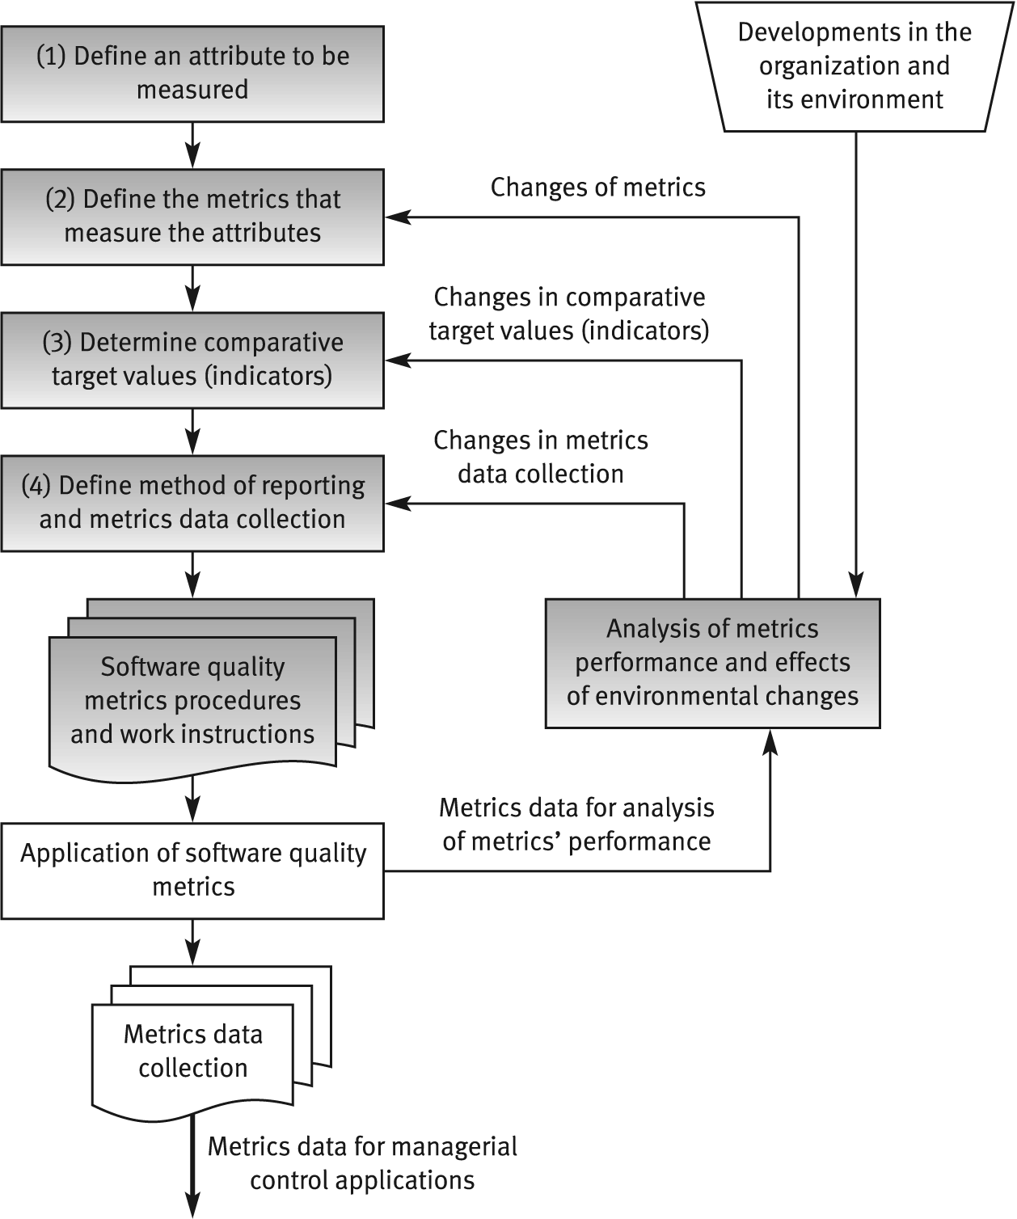
The process of
defining software quality metrics

Slide 74
General limitations of
quality metrics
* Budget constraints in allocating the necessary resources.
* Human factors, especially opposition of employees to evaluation of their activities.
* Validity Uncertainty regarding the data's, partial and biased reporting.

Slide 75
Examples of metrics
Requirements
Number of requirements that change during the rest of the software development process
if a large number changed during specification, design, …, something is wrong in the requirements phase and the quality of requirements engineers work
The less changes of requirements, the better requirements document quality

Slide 76
Examples of metrics
Inspection
number of faults found during inspection can be used as a metric to the quality of inspection process

Slide 77
Examples of metrics
Testing
Number of test cases executed
Number of bugs found per thousand of code
And more possible metrics

Slide 78
Examples of metrics
Maintainability metrics
Total number of faults reported
classifications by severity, fault type
status of fault reports (reported/fixed)
Detection and correction times

Slide 79
Examples of metrics
Reliability quality factor
Count of number of system failure (System down)
Total of minutes/hours per week or month

Slide 80
An example
Programmers productivity using error severity and density
We will consider error density and error severity
Assume that we have three levels of severity
Low severity errors Wight is 1
Medium Severity Error Wight is 3
High Severity Error Wight is 15
Two Programmers produced 3 KLOC per day
After inspection, we found 100 low severity error, 20 medium severity errors and 10 High severity errors in the code of Programmer 1
And 300 low severity error, 10 medium severity errors and 2 High severity errors in the code of Programmer 2
Which programmer has the highest code quality ?

Slide 81
Other Metrics
Understanding
Learning time: Time for new user to gain basic understanding of features of the software
Ease of learning
Learning time: Time for new user to learn how to perform basic functions of the software
Operability
Operation time: Time required for a user to perform operation(s) of the software
Usability
Human factors: Number of negative comments from new users regarding ergonomics, human factors, etc.

Slide 82
Other Metrics
Number and type of defects found during requirements, design, code, and test inspections
Number of pages of documentation delivered
Number of new source lines of code created
Number of source lines of code delivered
Total number or source lines of code delivered
Average complexity of all modules delivered
Average size of modules
Total number of modules
Total number of bugs found as a result of unit testing
Total number of bugs found as a result of integration testing
Total number of bugs found as a result of validation testing
Productivity, as measured by KLOC per person-hour

Slide 83
Software Quality Metrics Analysis

Slide 84
Can You Answer these Questions about Your Software Product?
How large was the product?
What was the overall productivity of the software engineering group on the product?
How many bugs were found before it was released?
How many bugs did the customers find in the first three months after release?
Was the overall quality better or worse than previous products?

Slide 85
Advantages of Collecting Software Quality Metrics
Objective assessments as to whether quality requirements are being met can be made during development
A quantitative assessment of quality can provide the basis for decisions regarding the software’s fitness for use
The effectiveness of the software development process can be objectively assessed

Slide 86
Terminology
Measure: Quantitative indication of the extent, amount, dimension, or size of some attribute of a product or process. A single data point
Metrics: The degree to which a system, component, or process possesses a given attribute. Relates several measures (e.g. average number of errors found per person hour)
Indicators: A combination of metrics that provides insight into the software process, project or product
Direct Metrics: Immediately measurable attributes (e.g. line of code, execution speed, defects reported)
Indirect Metrics: Aspects that are not immediately quantifiable (e.g. functionality, quantity, reliability)
Faults:
Errors: Faults found by the practitioners during software development
Defects: Faults found by the customers after release

Slide 87
A Good Manager Measures
process
process metrics
project metrics
measurement
product metrics
product
What do we
“Not everything that can be counted counts, and not everything that counts can be counted.” - Einstein
use as a
basis?
• size?
• function?

Slide 88
Process Metrics
Focus on quality achieved as a consequence of a repeatable or managed process. Strategic and Long Term.
Statistical Software Process Improvement (SSPI). Error Categorization and Analysis:
All errors and defects are categorized by origin
The cost to correct each error and defect is recorded
The number of errors and defects in each category is computed
Data is analyzed to find categories that result in the highest cost to the organization
Plans are developed to modify the process
Defect Removal Efficiency (DRE). Relationship between errors (E) and defects (D). The ideal is a DRE of 1:

Slide 89
Project Metrics
Used by a project manager and software team to adapt project work flow and technical activities. Tactical and Short Term.
Purpose:
Minimize the development schedule by making the necessary adjustments to avoid delays and mitigate problems
Assess product quality on an ongoing basis
Metrics:
Effort or time per SE task
Errors uncovered per review hour
Scheduled vs. actual milestone dates
Number of changes and their characteristics
Distribution of effort on SE tasks

Slide 90
Product Metrics
Focus on the quality of deliverables
Product metrics are combined across several projects to produce process metrics
Metrics for the product:
Measures of the Analysis Model
Complexity of the Design Model
Internal algorithmic complexity
Architectural complexity
Data flow complexity
Code metrics

Slide 91
Metrics Guidelines
Use common sense and organizational sensitivity when interpreting metrics data
Provide regular feedback to the individuals and teams who have worked to collect measures and metrics.
Don’t use metrics to appraise individuals
Work with practitioners and teams to set clear goals and metrics that will be used to achieve them
Never use metrics to threaten individuals or teams
Metrics data that indicate a problem area should not be considered “negative.” These data are merely an indicator for process improvement
Don’t obsess on a single metric to the exclusion of other important metrics

Slide 92
Normalization for Metrics
How does an organization combine metrics that come from different individuals or projects?
Depend on the size and complexity of the projec
Normalization: compensate for complexity aspects particular to a product
Normalization approaches:
Size oriented (lines of code approach)
Function oriented (function point approach)

Slide 93
Typical Normalized Metrics
Project | LOC | FP | Effort (P/M) | R(000) | Pp. doc | Errors | Defects | People
alpha | 12100 | 189 | 24 | 168 | 365 | 134 | 29 | 3
beta | 27200 | 388 | 62 | 440 | 1224 | 321 | 86 | 5
gamma | 20200 | 631 | 43 | 314 | 1050 | 256 | 64 | 6
Size-Oriented:
errors per KLOC (thousand lines of code), defects per KLOC, R per LOC, page of documentation per KLOC, errors / person-month, LOC per person-month, R / page of documentation
Function-Oriented:
errors per FP, defects per FP, R per FP, pages of documentation per FP, FP per person-month

Slide 94
Quality Aspect 1: Reliability
Reliability refers to the level of risk inherent in a software product, and the likelihood it will fail. It also addresses “stability,” as termed by ISO: how likely are there to be regressions in the software when changes are made.
Why measure reliability? To reduce and prevent severe malfunctions or outages, and errors that can affect users and decrease user satisfaction. Software is better if it fails less often, and easily recovers from failure when it happens.

Slide 95
How can you measure reliability?
Production incidents – A good measure of a system’s reliability is the number of high priority bugs identified in production.
Reliability testing – Common types of reliability testing are load testing, which checks how the software functions under high loads, and regression testing, which checks how many new defects are introduced when software undergoes changes. The aggregate results of these tests over time can be a measure of software resilience.
Reliability evaluation – An in-depth test conducted by experts who construct an operational environment simulating the real environment in which the software will be run. In this simulated environment, they test how the software works in a steady state, and with certain expected growth (e.g. more users or higher throughput).
Average failure rate – Measures the average number of failures per period per deployed unit or user of the software.
Mean time between failures (MTBF) – a metric used to measure uptime, or the amount of time software is expected to work correctly until the next major failure.

Slide 96
Quality Aspect 2: Performance
Why measure performance? To understand the level of performance experienced by users and how it impacts their usage of the software. Software is better if it meets or exceeds the level of performance users expect.

Slide 97
How can you measure performance?
Load testing – Conducted to understand the behavior of the system under a certain load, for example, with 1,000 concurrent users.
Stress testing – Understanding the upper limit of capacity of the system.
Soak testing – Checking if the system can handle a certain load for a prolonged period of time, and when performance starts to degrade.
Application performance monitoring (APM) – This is a new category of software that can provide detailed metrics of performance from the user’s perspective.

Slide 98
Quality Aspect 4: Maintainability and Code Quality
Software maintainability is the ease with which software can be adapted to other purposes, how portable it is between environments, and whether it is transferable from one development team or from one product to another. Maintainability is closely related to code quality. If code is of high quality, the software is likely to be more easily maintainable
Why measure maintainability and code quality? This is an aspect of software quality that is more significant to the organization developing the software, but it also indirectly affects users. Software is better if it is maintainable because it will take less time and cost to adapt it to users’ changing requirements. Software which is maintainable and has high quality code is also more likely to have improved reliability, performance and security.

Slide 99
Quality Aspect 3: Security
Security, in the context of software quality, reflects how likely it is that attackers might breach the software, interrupt its activity or gain access to sensitive information, due to poor coding practices and architecture
Why measure security? Increasingly, users rely on software to perform sensitive operations related to their personal lives and businesses. Software is better if it is less vulnerable to security breaches.

Slide 100
How can you measure software security?
Number of vulnerabilities – It is possible to scan software applications to identify known vulnerabilities. The number of vulnerabilities found is a good (negative) measure of security.
Time to resolution – How long does it take from the time a vulnerability was introduced in the software until a fix or patch was released?
Deployment of security updates – For software deployed on users equipment, how many users have actually installed a patch or security update?
Actual security incidents, severity and total time of attacks – How many times was a system actually breached, how badly did the breach affect users, and for how long?

Slide 101
How to measure maintainability and code quality?
Lines of code – A very simple metric that has an impact on the maintainability of a system. Software with more lines of code tends to be more difficult to maintain and more prone to code quality issues. The image below shows lines of code on several popular PHP frameworks, using several measurement techniques.
Static code analysis – Automatic examination of code to identify problems and ensure the code adheres to industry standards. Static analysis is done directly on the code without actually executing the software.
Software complexity metrics – There are several ways to measure how complex software is, such as cyclomatic complexity and N-node complexity. Code that is more complex is likely to be less maintainable.

Slide 102
Quality Aspect 5: Rate of Delivery
Rate of software delivery is related to quality, because a new version of a software system will typically contain improvements that can impact the user. A higher frequency of releases that are delivered to the user should, in theory, mean that the user gets better software faster.

Slide 103
How to measure rate of software delivery?
Number of software releases – This is the basic measurement of how frequently new software is delivered to users.
Agile stories which are “done” in a certain time period – Counting the number of “stories,” or user requirements, which are actually shipped to the user, provides a more granular measure of the rate of delivery.
User consumption of releases – For example, measuring the number of users who download or install a new patch or software update.

Slide 104
The Software Quality Metrics Framework
Quality requirements that the software product must meet
Quality factors – Management-oriented attributes of software that contribute to its quality
Quality subfactors – Decompositions of a quality factor to its technical components
Metrics – quantitative measures of the degree to which given attributes (factors) are present

Slide 105
Example
Quality requirement – “The product will be easy to use”
Quality factor(s) – Usability (An attribute that bears on the effort needed for use and on the assessment of such use by users)
Quality subfactors – Understandability, ease of learning, operability, communicativeness

Slide 106
Subfactors
Understandability – The amount of effort required to understand software
Ease of learning – The degree to which user effort required to learn how to use the software is minimized
Operability – The degree to which the effort required to perform an operation is minimized
Communicativeness – The degree to which software is designed in accordance with the psychological characteristics of users

Slide 107
Direct Metrics
Understanding
Learning time: Time for new user to gain basic understanding of features of the software
Ease of learning
Learning time: Time for new user to learn how to perform basic functions of the software
Operability
Operation time: Time required for a user to perform operation(s) of the software
Communicativeness
Human factors: Number of negative comments from new users regarding ergonomics, human factors, etc.

Slide 108
Types of Metrics
Direct metric – One that does not depend upon the measure of other attributes
Software quality metric – A function whose inputs are software measures and whose output is a single numerical value that can be interpreted as the degree to which software possesses a given attribute that affects its quality

Slide 109
Types of Metrics (cont’d)
Process metric – A metric used to measure characteristics of the methods, techniques, and tools employed in developing, implementing, and maintaining a software system
Product metric – A metric used to measure that characteristic of any product of the software development process

Slide 110
IEEE Software Metrics Methodology
Establish software quality requirements
Identify software quality metrics
Implement the software quality metrics
Analyze the software metrics results
Validate the software quality metrics

Slide 111
Establish Software Quality Requirements
What group is empowered to define software quality requirements?
How should customers provide input?
How are requirements conflicts resolved?

Slide 112
Identify Software Quality Metrics
Specify important quality factors and subfactors
Identify direct metrics
Name
Costs
Target value
Tools
Application
Data items
Computation

Slide 113
Example of Documenting a Metric
Item | Description
Name | Number of defects detected in selected modules
Costs | Minimal: data can be obtained from bug-tracking tool
Target Value | 5
Tools | Spreadsheet
Application | Metric is used for relative comparison to values obtained for other modules
Data Items | Count of defects detected at code inspections
Computation | Sum number of defects reported against specific modules

Slide 114
Implement the Collection of Data
Item | Description
Name | Name given to a data item
Metrics | Metrics associated with the data item
Definition | Straightforward description of the data item
Source | Location of where the data originates
Procedures | Procedures (manual or automated) for collecting the data
Representation | Manner in which data is represented, for example, precision, format, units, etc.
Storage | Location of where the data is stored

Slide 115
Analyze Software Quality Metric Results
Results need to be analyzed within the context of the project’s overall software quality requirements
Any metrics that fall outside of their respective targets should be identified for further analysis

Slide 116
Validate the Software Quality Metrics
Assess the statistical significance of the metrics to the quality factors they represent
See the IEEE Standard 1061-1998 for a thorough description of this process

Slide 117
Metrics that Support Software Verification Activities
Complexity Metrics
The McCabe Cyclomatic Complexity Metric
Halstead’s Software Science Complexity Metric
Defect Metrics
Product Metrics
Process Metrics

Slide 118
Complexity Metrics Can Be Used to Identify
Candidate modules for code inspections
Areas where redesign may be appropriate
Areas where additional documentation is required
Areas where additional testing may be required

Slide 119
Product Metrics
Number and type of defects found during requirements, design, code, and test inspections
Number of pages of documentation delivered
Number of new source lines of code created
Number of source lines of code delivered
Total number or source lines of code delivered
Average complexity of all modules delivered

Slide 120
Product Metrics (cont’d)
Average size of modules
Total number of modules
Total number of bugs found as a result of unit testing
Total number of bugs found as a result of integration testing
Total number of bugs found as a result of validation testing
Productivity, as measured by KLOC per person-hour

Slide 121
Process Metrics
Average find-fix cycle time
Number of person-hours per inspection
Number of person-hours per KLOC
Average number of defects found per inspection
Number of defects found during inspections in each defect category
Average amount of rework time
Percentage of modules that were inspected

Slide 122
Attributes of a Measurement Program – according to Humphrey
The measures should be robust
The measures should suggest a norm
The measures should relate to specific product and process properties
The measures should suggest an improvement strategy

Slide 123
Attributes of a Measurement Program – according to Humphrey (cont’d)
The measures should be a natural result of the software development process
The measures should be simple
The measures should be predictable and trackable
The measures should not be used as part of a person’s performance evaluation

Slide 124
Template for Software Quality Goal Definition
Purpose: To (characterize, evaluate, predict, monitor, etc.) the (process, product, model, metric, etc.) in order to (understand, plan, assess, manage, control, engineer, learn, improve, etc.) it.
Example: To evaluate the maintenance process in order to improve it.

Slide 125
Template for Software Quality Goal Definition (cont’d)
Perspective: Examine the (cost, effectiveness, correctness, defects, changes, product measures, etc.) from the viewpoint of the (developer, manager, customer, etc.)
Example: Examine the effectiveness from the viewpoint of the customer.

Slide 126
Template for Software Quality Goal Definition (cont’d)
Environment: The environment consists of the following: process factors, people factors, methods, tools, constraints, etc.
Example: The maintenance staff are poorly motivated programmers who have limited access to tools.

Slide 127
Determining Metrics
Goal | Questions | Metrics
Evaluate | How fast are fixes to customer reported problems made? What is the quality of fixes delivered? | Average effort to fix a problem Percentage of incorrect fixes

Slide 128
ADMC Exercise
An SDLC that consists of six phases
Requirements ( 3 weeks delay)
Analysis (2 weeks delay)
Logical design (0 weeks delay)
Physical design ( 4 weeks delay
Implementation (10 weeks delay)
Testing ( 6 weeks delay) ADMC ?

